Slide 1


Economic Performance Under US Presidents
*Not endorsed by the President
Sid Lamsal

Slide 2

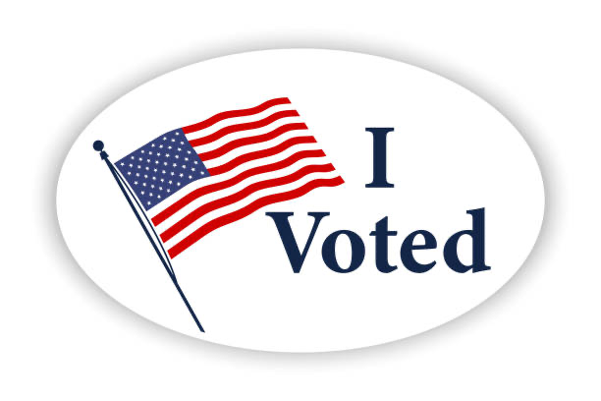
What a Coincidence

Slide 3
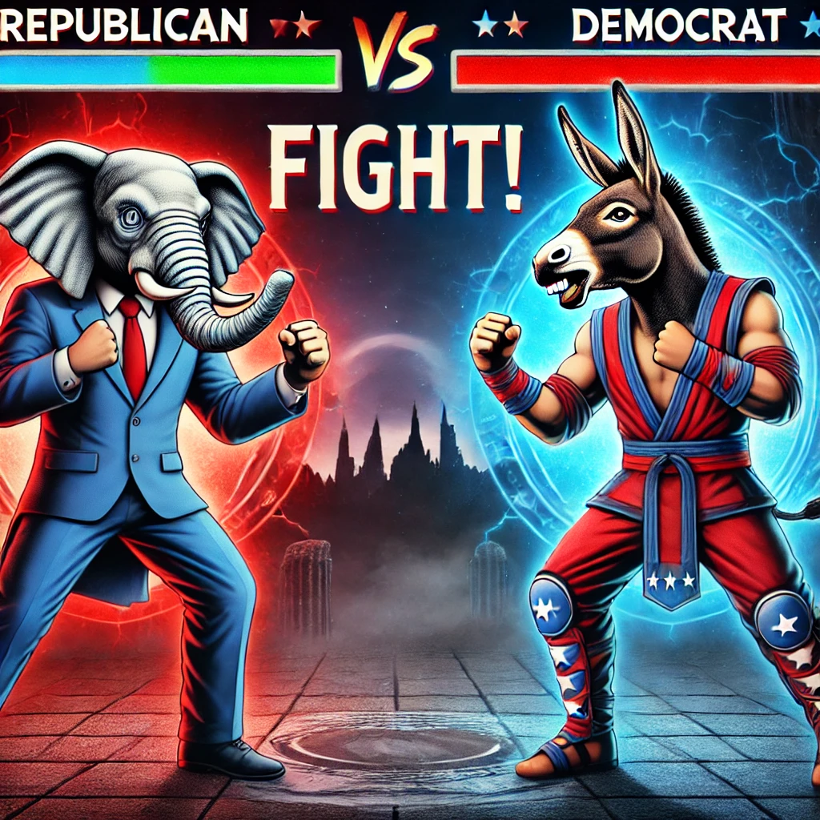
Dem vs. GOP Economies: What Trends Keep a Party in Power?
*AI Generated

Slide 4
Datasets
Economic Data: Quarterly economy stats from 1956-Q1 to 2024-Q4
Numerical columns are C.C. Growth rates to adjust for inflation
n/a values are linearly interpolated
Aggregated
Election Data: Q4 economic data for election years + approval and voter turnout
Used for predicting if party wins election

Slide 5
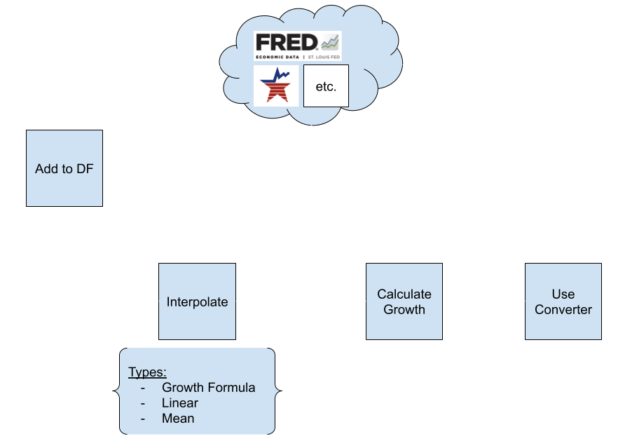

Slide 6
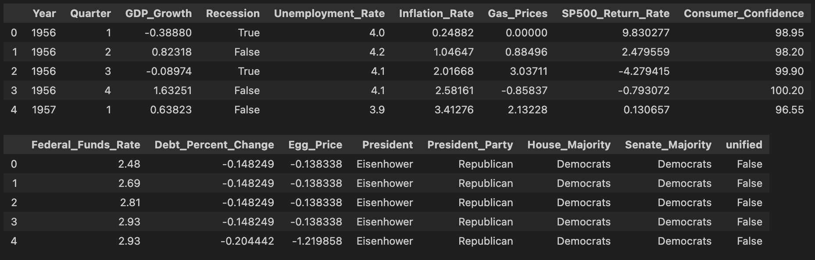
Result: Quarterly Economy DF

Slide 7
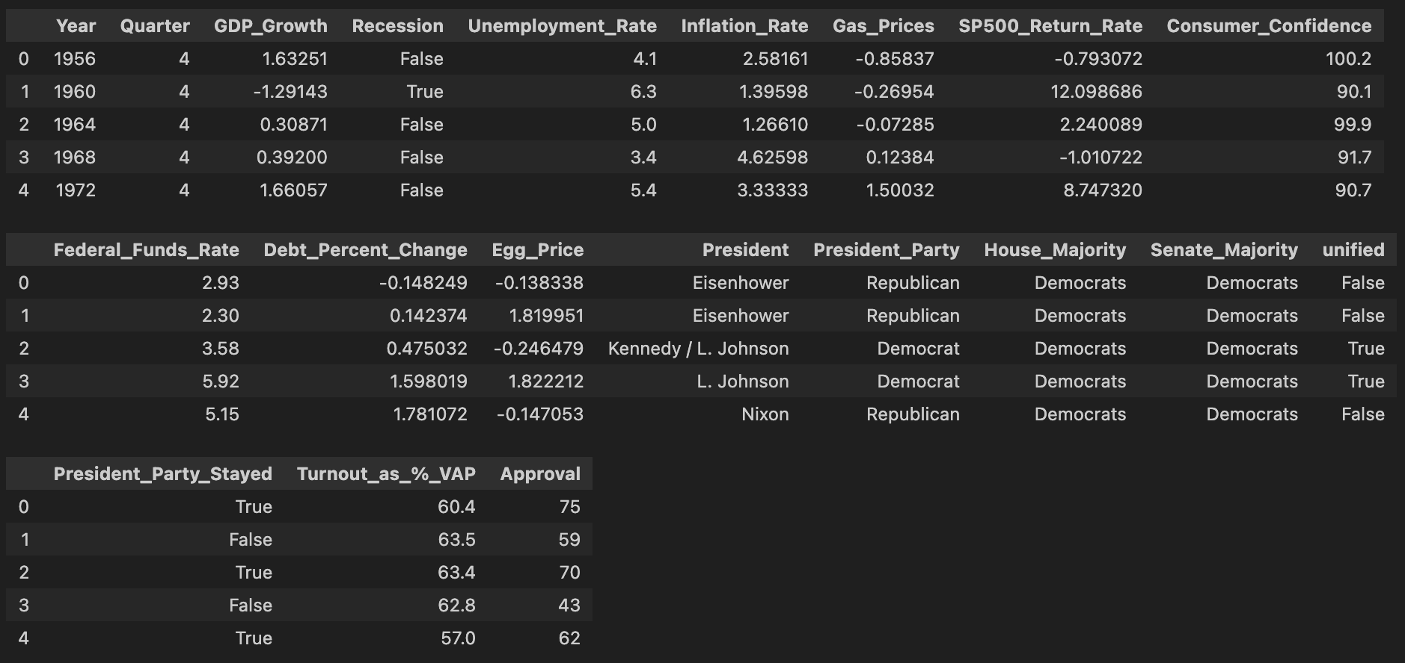
Result: Q4 Election Year Economy DF
Only Q4 election years in this DF
…
Not included in economy DF

Slide 8
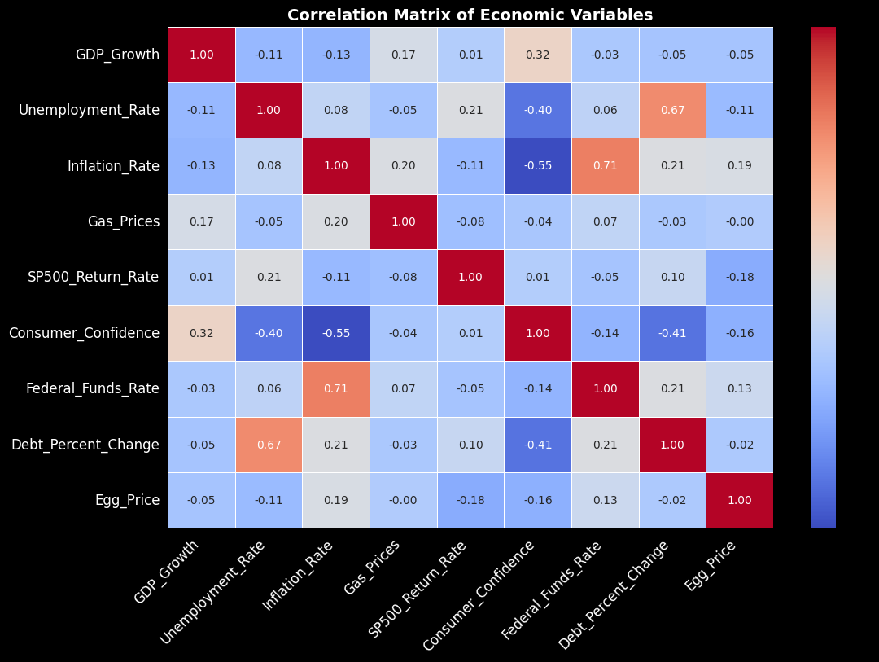

Slide 9
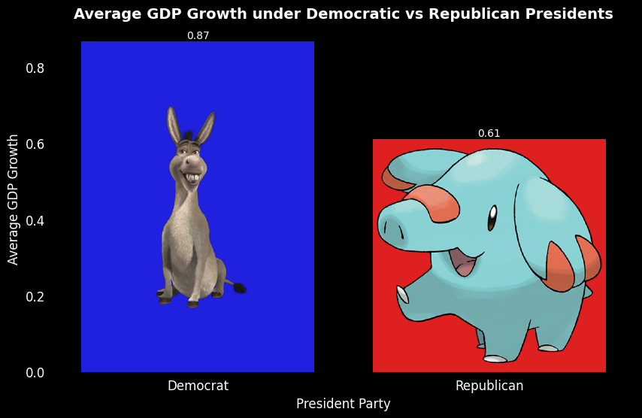

Slide 10
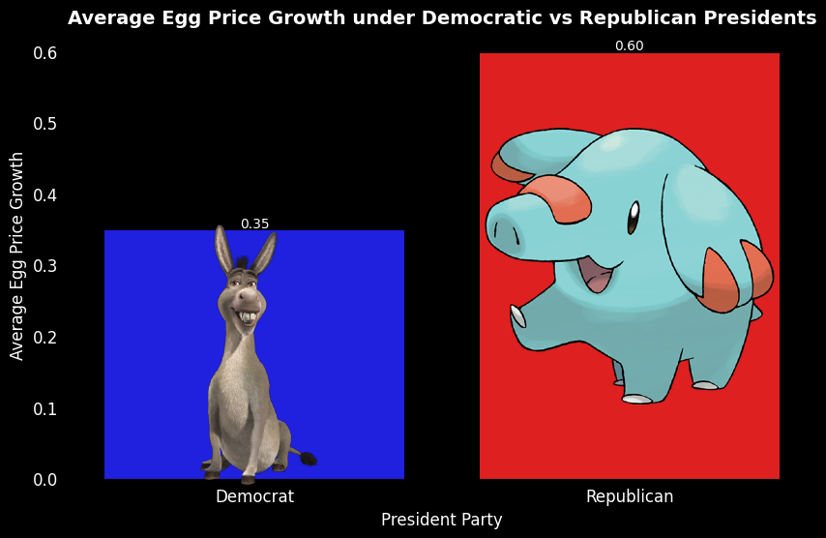

Slide 11
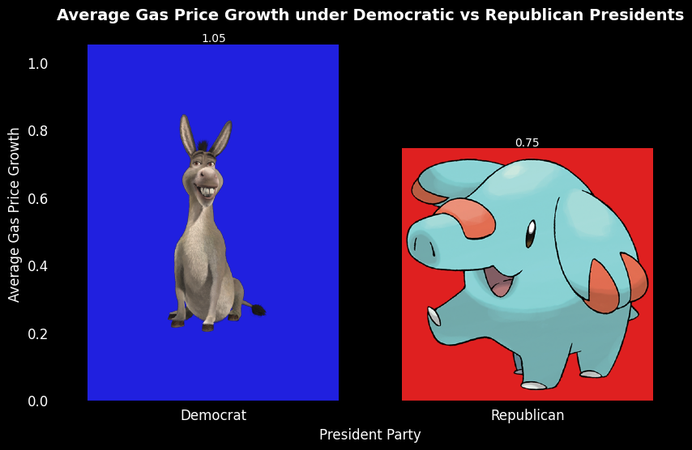

Slide 12
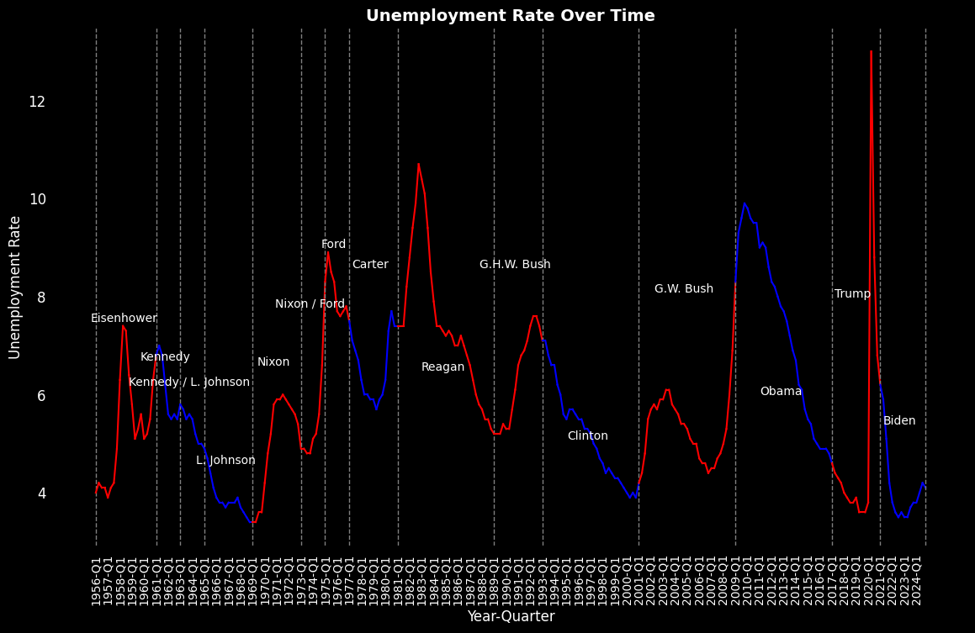
Typically lower under Dems.

Slide 13
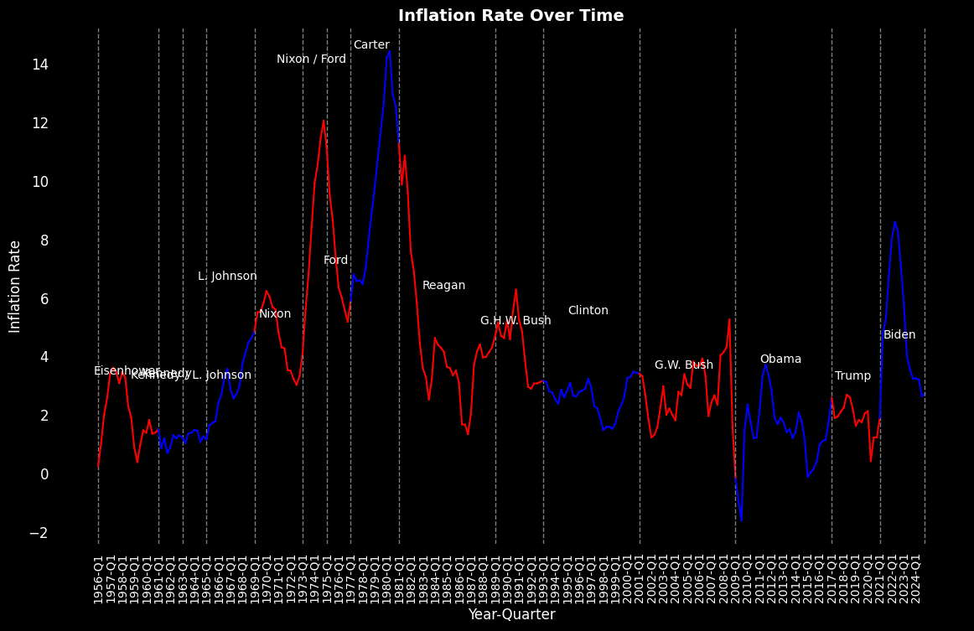
No visible correlation

Slide 14
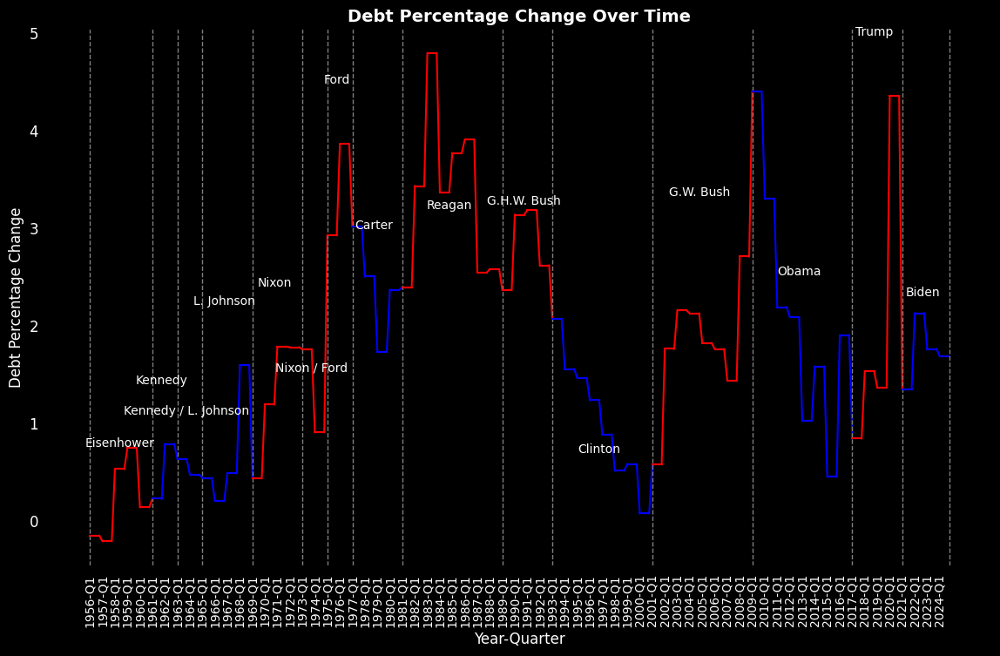
Typically lower under Dems.

Slide 15
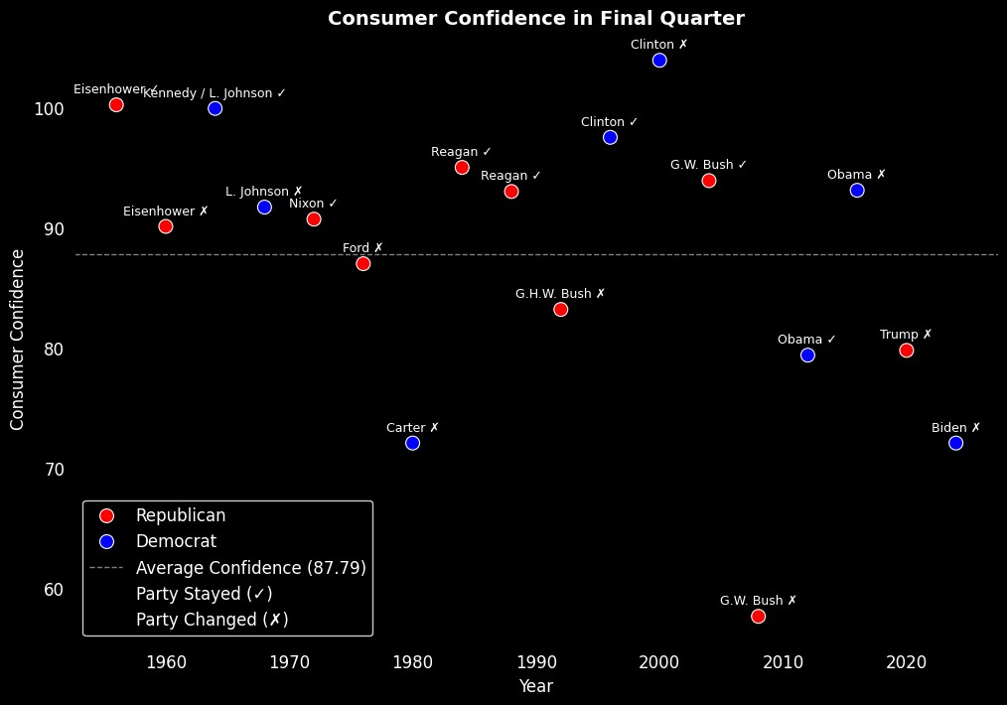
Low CC in final quarter = likely change parties

Slide 16
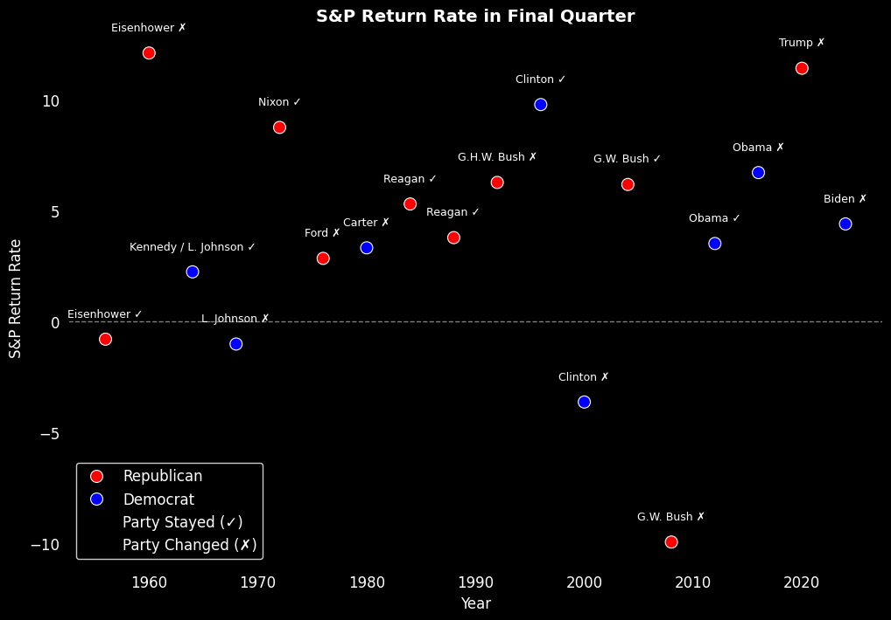
Positive slope over time
S&P usually positive in election quarter

Slide 17
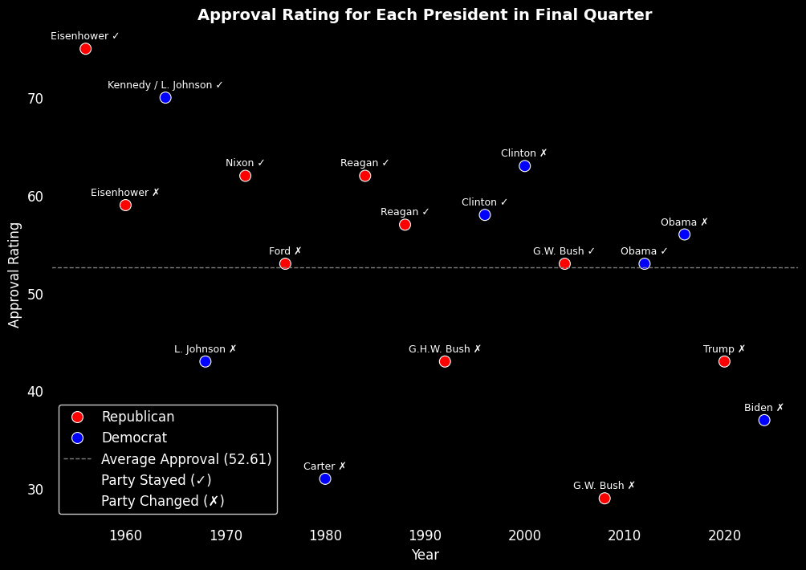
Low approval in final quarter = likely change parties
Downward slope

Slide 18
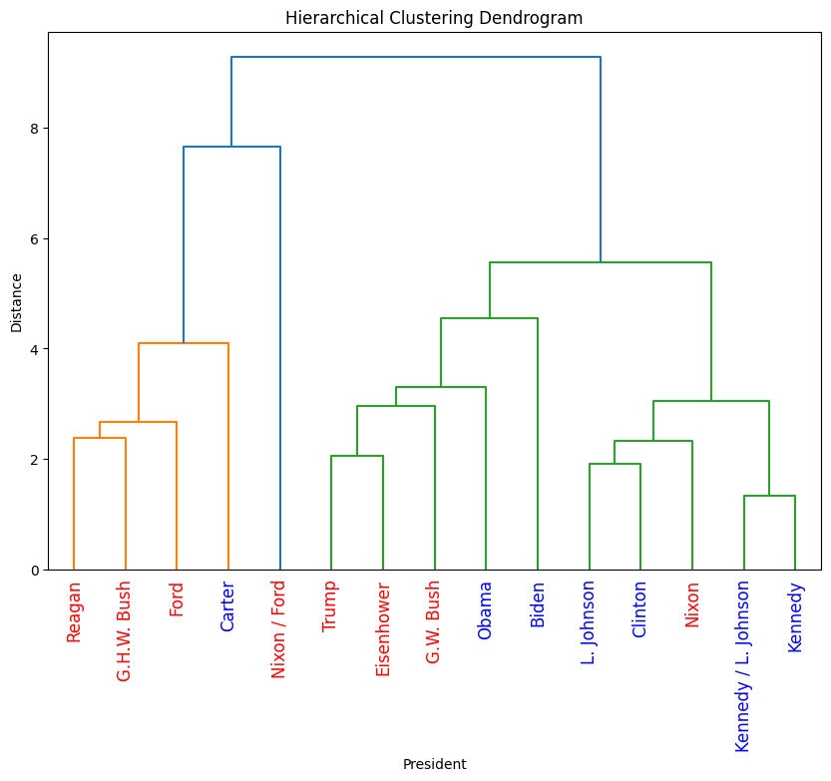
Result: Hierarchical Clustering

Slide 19
Implications for stakeholders
Main: Voters & General Public
Help voters contextualize campaign promises.
Policymakers & Political Strategists
Which factors historically influence voter decisions.
Financial Analysts & Investors
Investment strategies tied to election cycles.

Slide 20
Ethical, legal, societal implications
More Transparency For Election Season
Better informed first time voters
B.S. detection
Political Polarization & Public Perception
Challenges misleading political narratives
Government and People Disconnected
Regardless of party, presidential approval is on the decline

